Slide 1


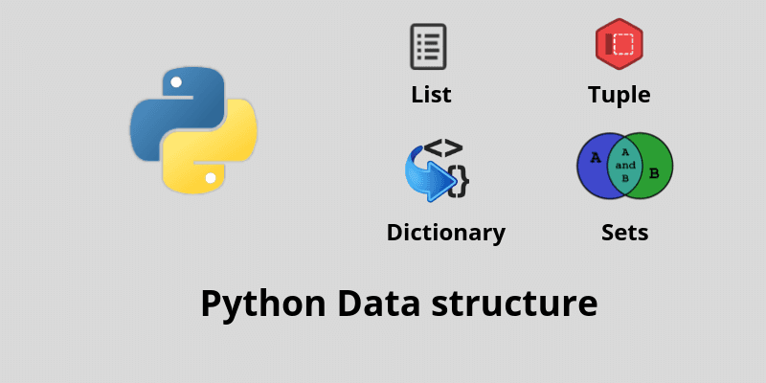




Slide 2
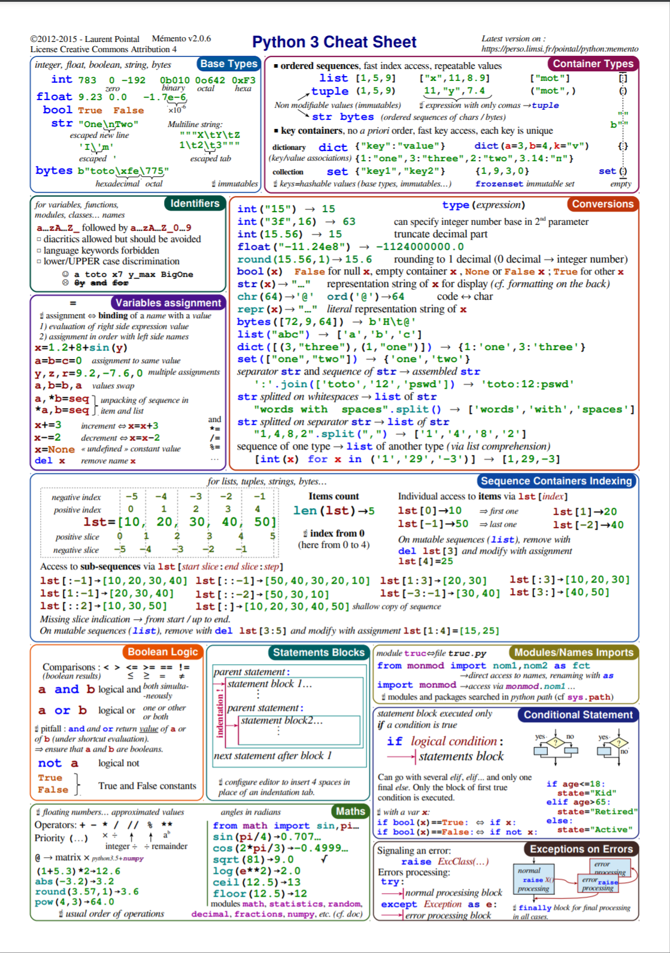
The Python 3 Cheat Sheet
https://perso.limsi.fr/pointal/python:memento

Slide 3
Literals
Notations for constant values

Slide 4
String Literals
Unicode => 1-4 bytes per character
”Hello”
’Hello’
f”Hello, I’m {name}”

Slide 5
Byte Literals
Not Unicode => 1 byte per character
b”Hello”
b’Hello’
B”Hello”
B’Hello’

Slide 6
Integer Literals
Regular Integers 42
True or False Same as 1 or 0
Hexadecimal 0xFFDA0
Binary 0b01001
Octal 0o1743

Slide 7
Floating Point Literals
42.
3.14
.031
2.99792e8
1_000_000

Slide 8
Imaginary Literals
3.14j
10.j
10j
.001j
1e100j
3.14e-10j
3.14_15_93j

Slide 9
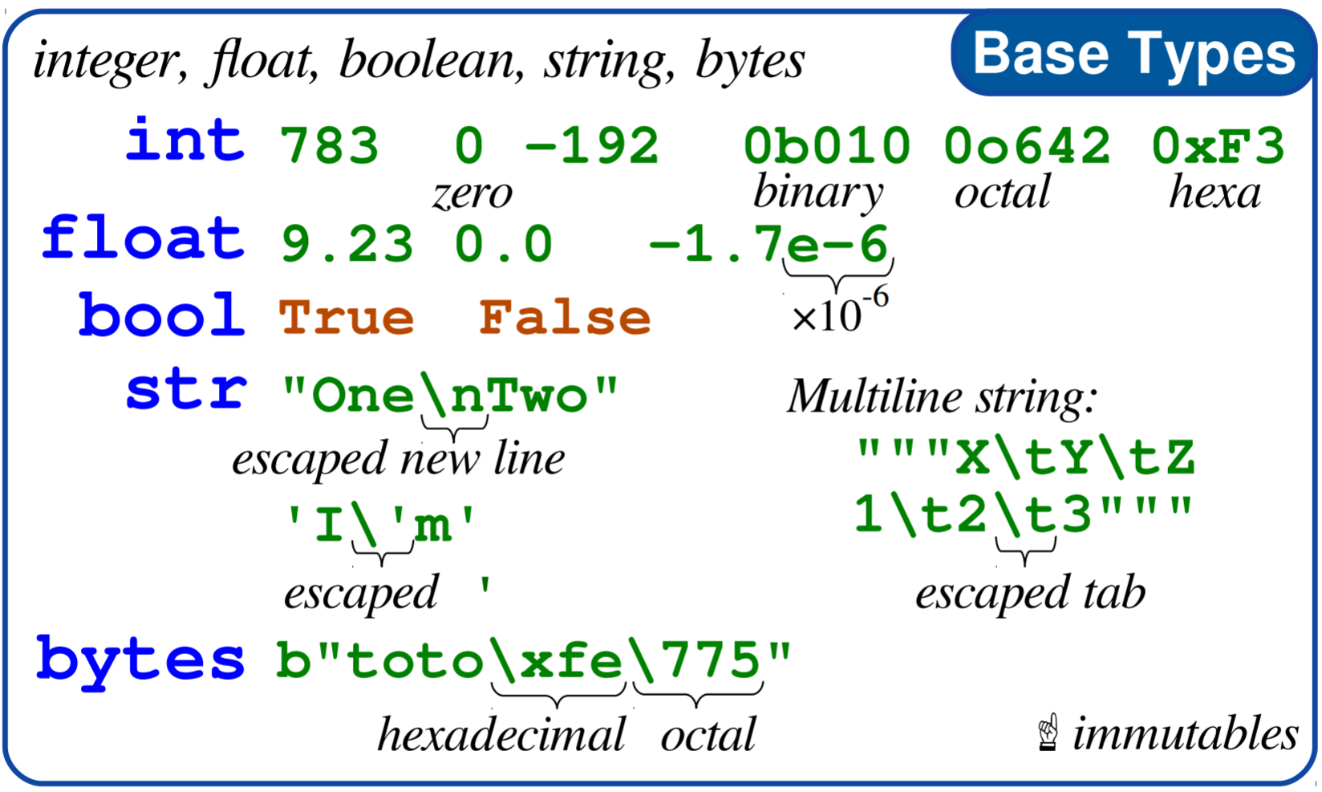
Base Types

Slide 10
Numbers

Slide 11
Types of Numbers
Integer (int)
Float (float)
Complex (complex)

Slide 12
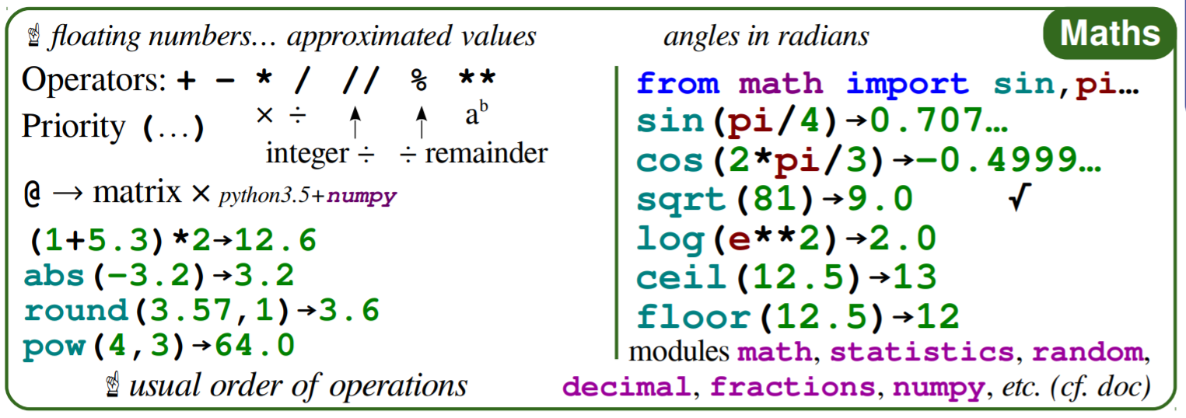
Operators

Slide 13
Containers

Slide 14
Categories of Containers
Sequences
Ordered set of objects
Indexed by non-negative integers: 0, 1, …, N-1
Lists, Tuples, Strings, Ranges and Bytes
Collections
Unordered set of object
Index by “keys”
Dictionaries and Sets

Slide 15
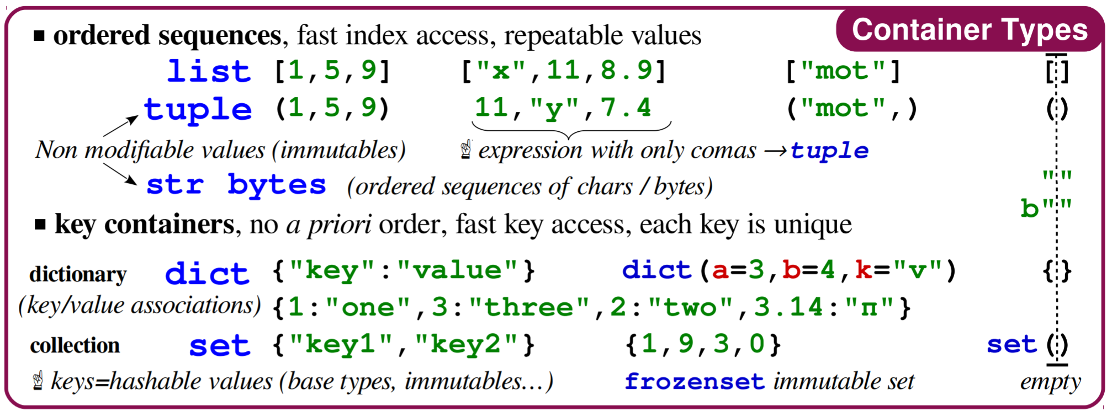
Containers

Slide 16
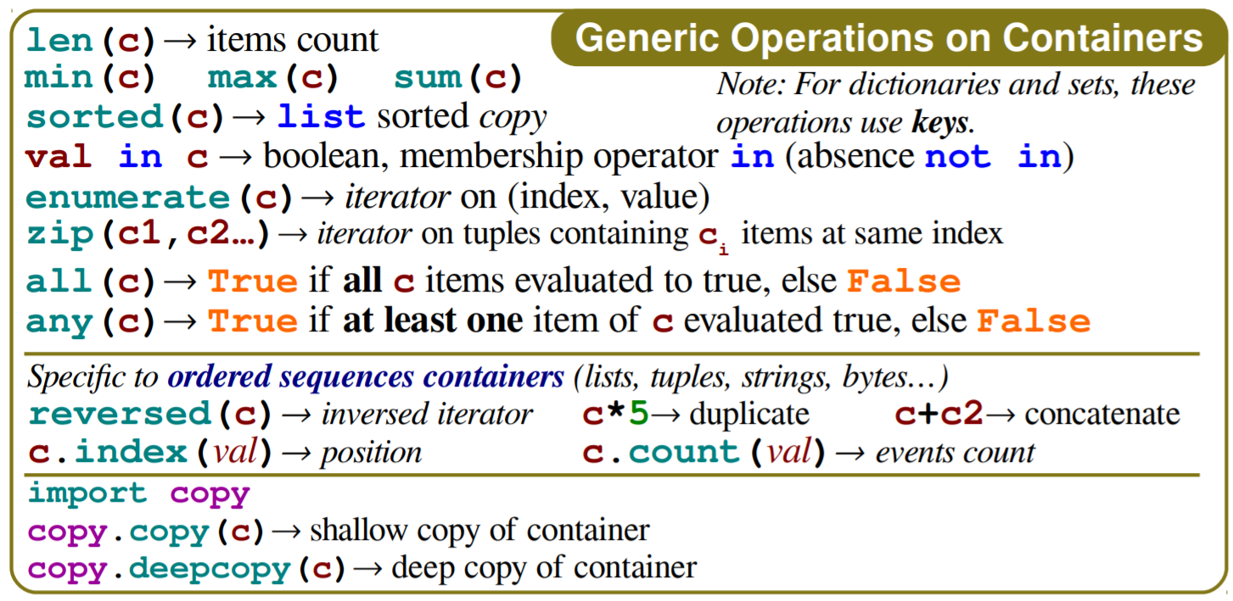
Container Operations

Slide 17
Immutable Sequences
Strings
A sequence of Unicode in range of U+0000 to U+10FFFF
‘Hello World’
Tuples
A sequence of arbitrary Python Objects separated by commas
4, ‘four’, 3.14 often written with optional parens (4, ‘four’, 3.14)
Bytes
Array of 8-bit bytes, integers 0 to 255
b’Hello World’
Ranges

Slide 18
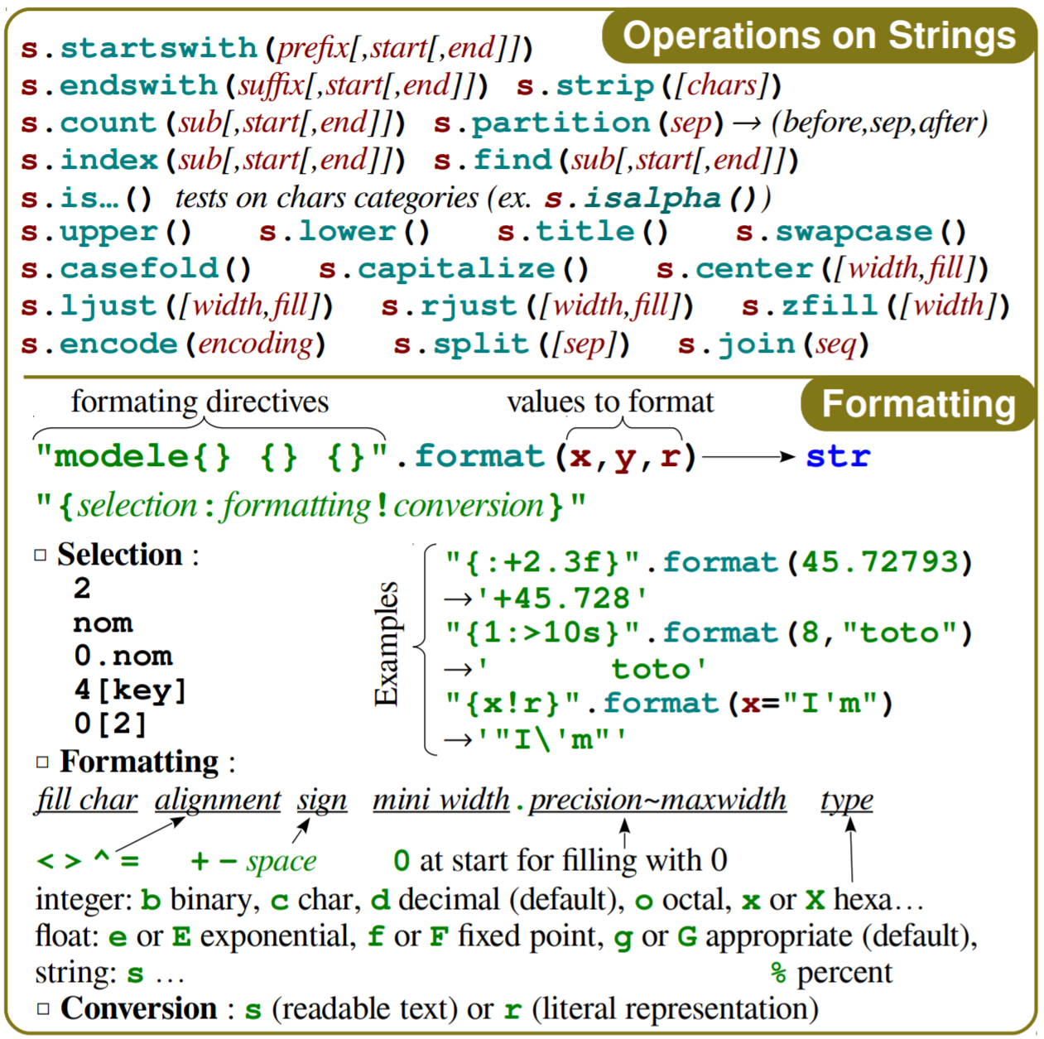
Strings

Slide 19
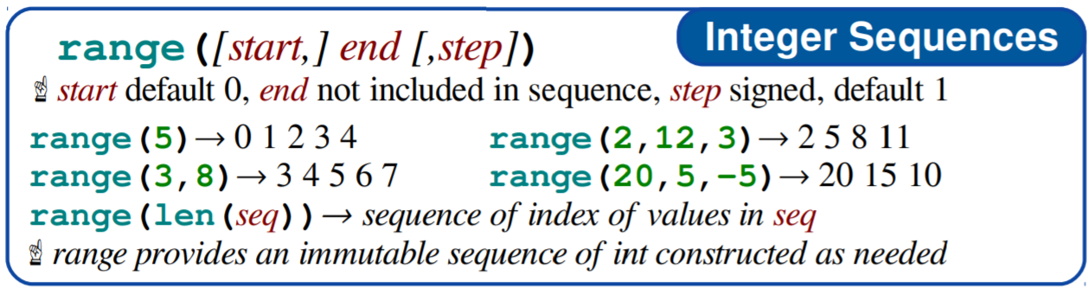
Ranges

Slide 20
Mutable Sequences
Lists
Sequence of arbitrary Python objects, separated by commas in [ ]
[4, ‘four’, 3.14] brackets required
Byte Arrays
Like immutable bytes objects but mutable
Only created with bytarray() constructor

Slide 21
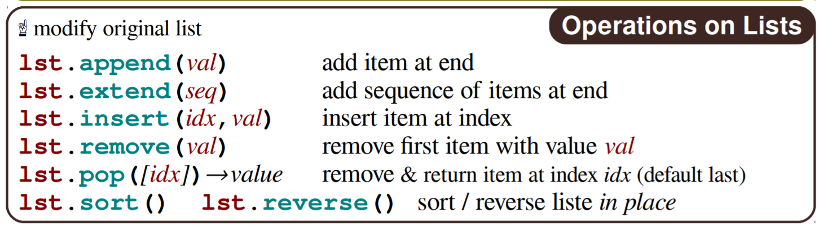
List Operations

Slide 22
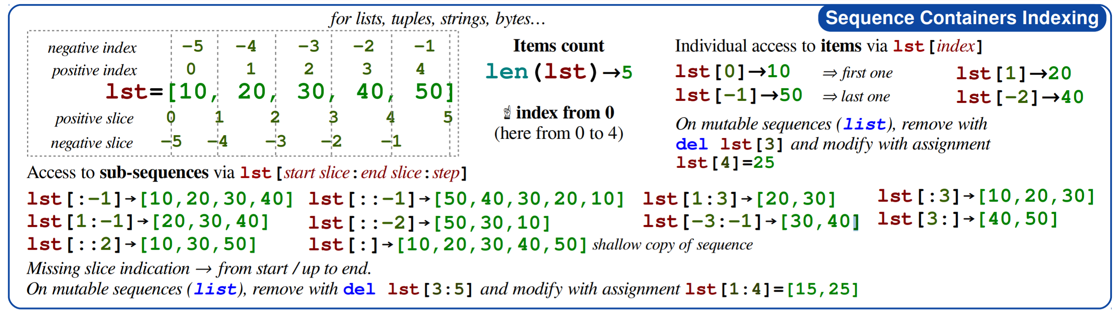
Sequence Indexing and Slicing Lists, Tuples, Strings, Bytes

Slide 23
Collections
Dictionaries
A set of Key:Value pairs. Access using Key
Keys are unique
Sets
A set of Keys, no Values. Access using Key
Keys are unique

Slide 24
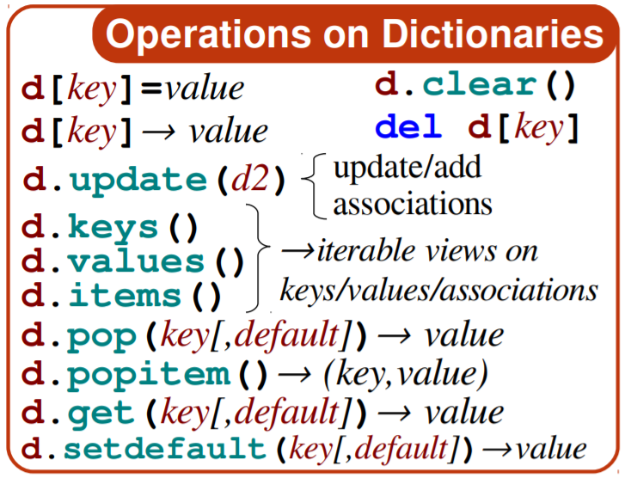
Dictionary Operations

Slide 25
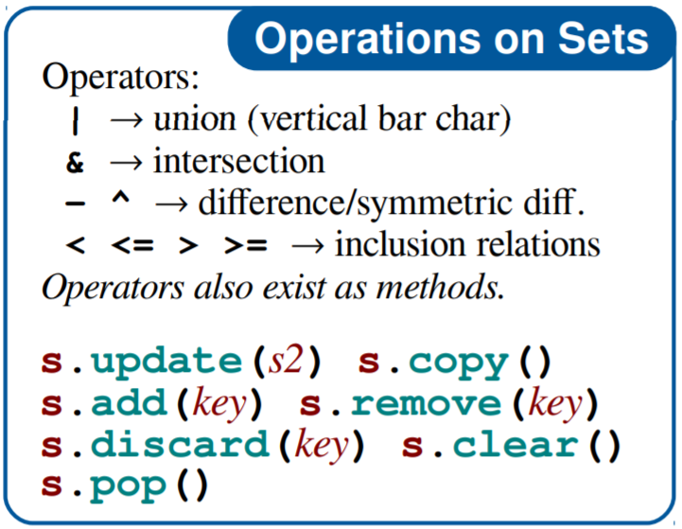
Set Operations

